Slide 1
Logistic Regression
حسين علي إبراهيم الشامي

Slide 2
Logistic Regression
Trains model on a data set
Model can then be used to classify new data
Example: Student Studying hours and their success/failure

Slide 3
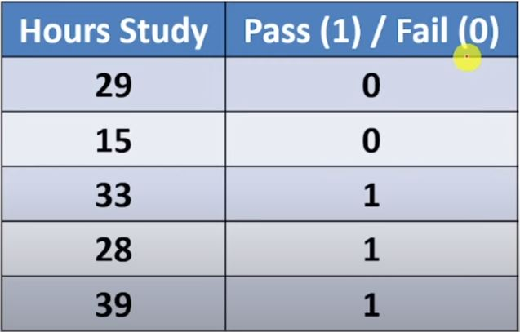
Example
Assume the model suggested by the optimizer for odds of passing is:
log(odds) = -64 + 2 * hours

Slide 4
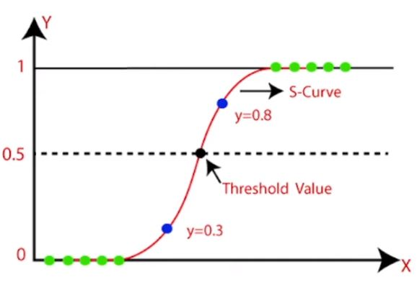
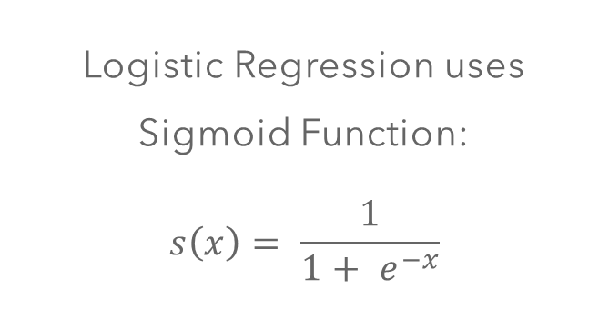
Example
Max Probability
Required Prop.
Logistic Regression uses Sigmoid Function:
$$s\left(x\right)= \frac{1}{1+ e^{−x}}$$
Min Probability

Slide 5



Example
If a student studies for 33, what is the probability that they pass the exam?
log(odds) = z = -64 + 2 * hours

Slide 6
Final Result
This means that if a student studies for 33 hours, then they have a chance of 88% that they succeed in the exam

